Slide 1
Kubernetes in 20 minutes or less
Tony Arkles, Persea Systems
tony@persea.ca – Feel free to get in touch!
https://github.com/tonyarkles/cmpt433-kubernetes

Slide 2
What’s this all about, anyway?
Automated rollouts and rollbacks
Service discovery and load balancing
Secrets and configuration management
Horizontal scaling
Failure recovery

Slide 3
What it’s not
Not a platform
But it does have hooks to integrate with provider-specific services
No application-level backend services
Not for any specific languages or frameworks
It’s like Dim Sum: there’s lots of options on the menu, and you can pick and choose which ones you want to eat.

Slide 4
What are the downsides?
It’s complicated - lots of moving parts, easy to get lost in it all.
Takes work upfront to understand the moving parts. Really.
Managing your own installation is complicated – if you want an on-prem self-managed install, you probably want a team dedicated to managing it.
But there many fantastic managed services that hide all that complexity for you

Slide 5
The GOLDEN nugget of it all
Declarative Configuration
You tell it how the world should be, and it does whatever it needs to do to make reality match your dream!
“Straightforward”:
You create K8s objects
The system does whatever it can to make sure those objects exist
Specs and status: what you want vs. what there currently is

Slide 6
Creating Objects
Objects are typically defined in yaml files (we’ll go through some examples)
The Objects have some metadata and a spec (object type, API version, and object-specific parameters)
Send them to the cluster using “kubectl apply -f”

Slide 7
Most important Object types
Pods: groups of containers that share a namespace and IP address
Ephemeral, disposable, not usually created manually
One-container-per-pod is the most common configuration
You can have filesystem volumes attached, but usually you don’t
Deployments: object that creates Pods using a template
Actually creates a ReplicaSet object, which then creates the Pods…
Services: abstract way to specify which ports to expose from a Pod to other Pods or the Internet

Slide 8
More Important Object Types
Ingress Controllers
Provide an HTTP/HTTPS interface from the outside world to Pods
Can handle HTTPS termination so that your Pods don’t have to worry about that
Ingress
Tells Ingress Controllers which Pods to route requests to
Can provide rules, filtering, etc.

Slide 9
Let’s do THIS!
Steps:
Create a Kubernetes cluster on DigitalOcean
Create an Ingress Controller
Set up DNS on DigitalOcean
Deploy our Frontend service
Setup Frontend Ingress
Deploy our Backend service with Ingress
Deploy cert-manager to auto-provision HTTPS certificates via LetsEncrypt
Muck with the Ingress Controller a bit
Push a new frontend service

Slide 10
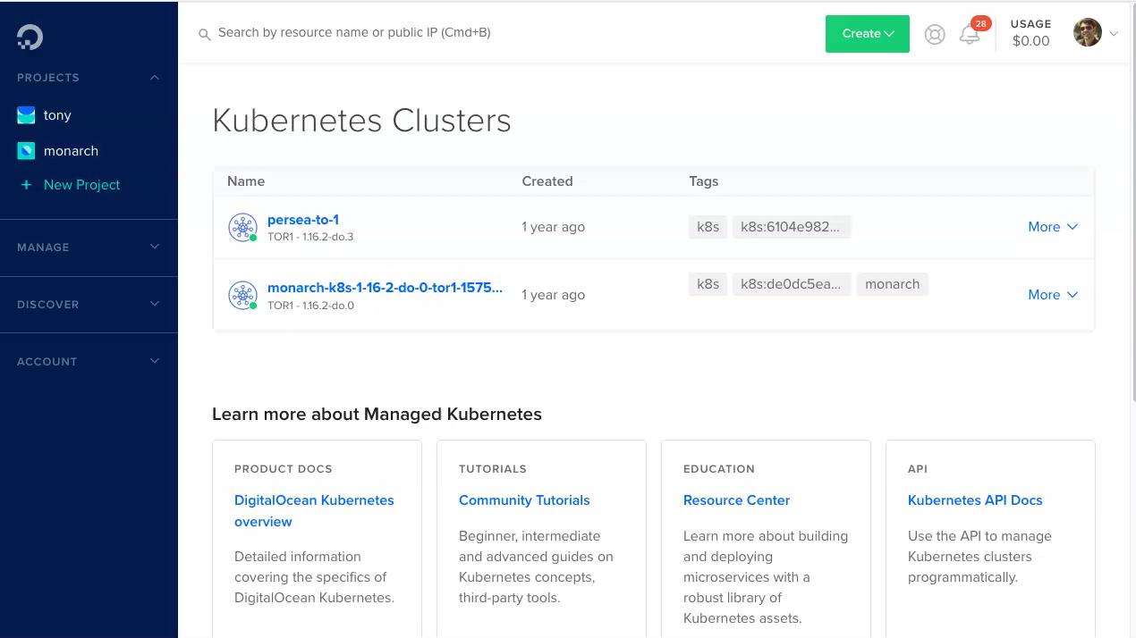
Creating the cluster

Slide 11
Creating an NGINX Ingress Controller
This serves as the externally-accessible HTTP/HTTPS endpoint for your cluster
The only part of it that’s going to have an externally-accessible IP
kubectl apply -f 01-deploy-ingress-nginx.yaml
This is provided by the k8s team. It’s a bit more complicated than most Pods/Services, because it interacts with the k8s infrastructure directly (your Pods probably won’t)

Slide 12
% kubectl apply -f 01-deploy-ingress-nginx.yaml
namespace/ingress-nginx created
serviceaccount/ingress-nginx created
configmap/ingress-nginx-controller created
clusterrole.rbac.authorization.k8s.io/ingress-nginx created
clusterrolebinding.rbac.authorization.k8s.io/ingress-nginx created
role.rbac.authorization.k8s.io/ingress-nginx created
rolebinding.rbac.authorization.k8s.io/ingress-nginx created
service/ingress-nginx-controller-admission created
service/ingress-nginx-controller created
deployment.apps/ingress-nginx-controller created
validatingwebhookconfiguration.admissionregistration.k8s.io/ingress-nginx-admission created
serviceaccount/ingress-nginx-admission created
clusterrole.rbac.authorization.k8s.io/ingress-nginx-admission created
clusterrolebinding.rbac.authorization.k8s.io/ingress-nginx-admission created
role.rbac.authorization.k8s.io/ingress-nginx-admission created
rolebinding.rbac.authorization.k8s.io/ingress-nginx-admission created
job.batch/ingress-nginx-admission-create created
job.batch/ingress-nginx-admission-patch created

Slide 13
Can inspect the services inside the ingress-nginx namespace to see what it created.
% kubectl get svc --namespace=ingress-nginx
NAME TYPE CLUSTER-IP EXTERNAL-IP PORT(S) AGE
ingress-nginx-controller LoadBalancer 10.245.40.221 174.138.112.66 80:32431/TCP,443:31364/TCP 5m39s
ingress-nginx-controller-admission ClusterIP 10.245.112.33 <none> 443/TCP 5m39s

Slide 14
Creating DNS Records
Two A records:
www.cmpt433.persea.ca to 174.138.112.66
api.cmpt433.persea.ca to 174.138.112.66
These both point at the nginx Ingress Controller

Slide 15
Test the DNS record:
% curl http://www.cmpt433.persea.ca/
<html>
<head><title>404 Not Found</title></head>
<body>
<center><h1>404 Not Found</h1></center>
<hr><center>nginx</center>
</body>
</html>

Slide 16
Creating our first deployment & Service
“Echo” is a container that responds to HTTP requests with static content
Creating a Deployment specifies which container to use
This will create a ReplicaSet with the specified number of copies of the service
The ReplicaSet will create Pods
The Pods will each have a copy of the Echo container running

Slide 17
apiVersion: apps/v1
kind: Deployment
metadata:
name: frontend-deployment
spec:
selector:
matchLabels:
app: frontend
replicas: 2
template:
metadata:
labels:
app: frontend
spec:
containers:
- name: frontend
image: hashicorp/http-echo
args:
- "-text=frontend"
ports:
- containerPort: 5678

Slide 18
apiVersion: v1
kind: Service
metadata:
name: frontend-service
spec:
selector:
app: frontend
ports:
- protocol: TCP
port: 80
targetPort: 5678

Slide 19
% kubectl apply -f 02-frontend-deployment.yaml
# Inspect the created objects:
% kubectl get deployments
NAME READY UP-TO-DATE AVAILABLE AGE
frontend-deployment 2/2 2 2 94s
% kubectl get replicasets
NAME DESIRED CURRENT READY AGE
frontend-deployment-69bdb54649 2 2 2 90s
% kubectl get pods
NAME READY STATUS RESTARTS AGE
frontend-deployment-69bdb54649-c452z 1/1 Running 0 23s
frontend-deployment-69bdb54649-dhpvw 1/1 Running 0 23s
% kubectl get services
NAME TYPE CLUSTER-IP EXTERNAL-IP PORT(S) AGE
frontend-service ClusterIP 10.245.129.102 <none> 80/TCP 2m16s
kubernetes ClusterIP 10.245.0.1 <none> 443/TCP 62m

Slide 20
Create an Ingress so that we can access from the internet
Without the Ingress, the Ingress Controller won’t route anything to our Pods
The Ingress Controller is the only thing with an Internet-facing IP, so… if it doesn’t let traffic in, there’s no other way to access the service

Slide 21
apiVersion: networking.k8s.io/v1
kind: Ingress
metadata:
name: frontend-ingress
spec:
rules:
- host: www.cmpt433.persea.ca
http:
paths:
- pathType: Prefix
path: "/"
backend:
service:
name: frontend-service
port:
number: 80

Slide 22
% curl http://www.cmpt433.persea.ca/
<html>
<head><title>404 Not Found</title></head>
<body>
<center><h1>404 Not Found</h1></center>
<hr><center>nginx</center>
</body>
</html>
% kubectl apply -f 03-frontend-ingress.yaml
ingress.networking.k8s.io/frontend-ingress created
% curl http://www.cmpt433.persea.ca/
frontend

Slide 23
Setting up the backend
Backend goes exactly the same as the Frontend
Create a Deployment (which creates a ReplicaSet and Pods)
Create a Service so that nodes inside the cluster can talk to it
Create an Ingress so that it’s exposed to the Internet through the Ingress Controller
I did it all in one step (see 04-backend.yaml)

Slide 24
% kubectl apply -f 04-backend.yaml
service/backend-service created
deployment.apps/backend-deployment created
ingress.networking.k8s.io/backend-ingress created
% curl http://www.cmpt433.persea.ca/
frontend
% curl http://api.cmpt433.persea.ca/
backend

Slide 25
Final Trick: Adding HTTPS
LetsEncrypt is a service that provides free HTTPS/TLS certificates!
Cert-manager.io gets installed into your cluster and automatically provisions certificates

Slide 26
% kubectl apply -f 05-cert-manager.yaml
customresourcedefinition.apiextensions.k8s.io/certificaterequests.cert-manager.io created
customresourcedefinition.apiextensions.k8s.io/certificates.cert-manager.io created
customresourcedefinition.apiextensions.k8s.io/challenges.acme.cert-manager.io created
customresourcedefinition.apiextensions.k8s.io/clusterissuers.cert-manager.io created
customresourcedefinition.apiextensions.k8s.io/issuers.cert-manager.io created
customresourcedefinition.apiextensions.k8s.io/orders.acme.cert-manager.io created
namespace/cert-manager created
serviceaccount/cert-manager-cainjector created
serviceaccount/cert-manager created
serviceaccount/cert-manager-webhook created
clusterrole.rbac.authorization.k8s.io/cert-manager-cainjector created
clusterrole.rbac.authorization.k8s.io/cert-manager-controller-issuers created
clusterrole.rbac.authorization.k8s.io/cert-manager-controller-clusterissuers created
clusterrole.rbac.authorization.k8s.io/cert-manager-controller-certificates created
clusterrole.rbac.authorization.k8s.io/cert-manager-controller-orders created
clusterrole.rbac.authorization.k8s.io/cert-manager-controller-challenges created
clusterrole.rbac.authorization.k8s.io/cert-manager-controller-ingress-shim created
clusterrole.rbac.authorization.k8s.io/cert-manager-view created
clusterrole.rbac.authorization.k8s.io/cert-manager-edit created
clusterrolebinding.rbac.authorization.k8s.io/cert-manager-cainjector created
clusterrolebinding.rbac.authorization.k8s.io/cert-manager-controller-issuers created
clusterrolebinding.rbac.authorization.k8s.io/cert-manager-controller-clusterissuers created
clusterrolebinding.rbac.authorization.k8s.io/cert-manager-controller-certificates created
clusterrolebinding.rbac.authorization.k8s.io/cert-manager-controller-orders created
clusterrolebinding.rbac.authorization.k8s.io/cert-manager-controller-challenges created
clusterrolebinding.rbac.authorization.k8s.io/cert-manager-controller-ingress-shim created
role.rbac.authorization.k8s.io/cert-manager-cainjector:leaderelection created
role.rbac.authorization.k8s.io/cert-manager:leaderelection created
role.rbac.authorization.k8s.io/cert-manager-webhook:dynamic-serving created
rolebinding.rbac.authorization.k8s.io/cert-manager-cainjector:leaderelection created
rolebinding.rbac.authorization.k8s.io/cert-manager:leaderelection created
rolebinding.rbac.authorization.k8s.io/cert-manager-webhook:dynamic-serving created
service/cert-manager created
service/cert-manager-webhook created
deployment.apps/cert-manager-cainjector created
deployment.apps/cert-manager created
deployment.apps/cert-manager-webhook created
mutatingwebhookconfiguration.admissionregistration.k8s.io/cert-manager-webhook created
validatingwebhookconfiguration.admissionregistration.k8s.io/cert-manager-webhook created

Slide 27
% kubectl get all --namespace=cert-manager
NAME READY STATUS RESTARTS AGE
pod/cert-manager-5597cff495-pst2q 1/1 Running 0 6m1s
pod/cert-manager-cainjector-bd5f9c764-mfcp7 1/1 Running 0 6m1s
pod/cert-manager-webhook-5f57f59fbc-gltt8 1/1 Running 0 6m
NAME TYPE CLUSTER-IP EXTERNAL-IP PORT(S) AGE
service/cert-manager ClusterIP 10.245.187.7 <none> 9402/TCP 6m1s
service/cert-manager-webhook ClusterIP 10.245.152.143 <none> 443/TCP 6m1s
NAME READY UP-TO-DATE AVAILABLE AGE
deployment.apps/cert-manager 1/1 1 1 6m2s
deployment.apps/cert-manager-cainjector 1/1 1 1 6m2s
deployment.apps/cert-manager-webhook 1/1 1 1 6m1s
NAME DESIRED CURRENT READY AGE
replicaset.apps/cert-manager-5597cff495 1 1 1 6m2s
replicaset.apps/cert-manager-cainjector-bd5f9c764 1 1 1 6m2s
replicaset.apps/cert-manager-webhook-5f57f59fbc 1 1 1 6m1s

Slide 28
Creating an Issuer
Cert-manager supports certificates from multiple sources
The LetsEncrypt protocol is called ACME
We fill in a couple of fields (email address, server URL) and set it up to do the requests over HTTP

Slide 29
MODIFY The Ingress to Use HTTPS
The frontend-ingress just needs:
The name of the Issuer to use to request a certificate
The hostname to request a certificate for
The name of a Secret object to store the certificate and key

Slide 30
Small modification to the nginx-Ingress
Because… reasons, there’s a small change needed to make this all work
In a nutshell, nodes from inside the cluster can’t access the load balancer on DigitalOcean (08-redeploy-ingress-nginx.yaml)

Slide 31
% curl https://www.cmpt433.persea.ca/
frontend
(This would error out if there wasn’t a valid HTTPS certificate)

Slide 32
Finally, Proving the Frontend can talk to the backend
Last step, I’m going to push a really simple service that makes a request to “backend-service” instead of just returning static text
09-frontend-deployment.yaml

Slide 33
% curl https://www.cmpt433.persea.ca/
frontend
% kubectl apply -f 09-frontend-deployment.yaml
service/frontend-service unchanged
deployment.apps/frontend-deployment configured
% curl https://www.cmpt433.persea.ca/
frontend
% kubectl get pods
NAME READY STATUS RESTARTS AGE
backend-deployment-57f7c9c789-p9w87 1/1 Running 0 2d16h
backend-deployment-57f7c9c789-s97zl 1/1 Running 0 2d16h
frontend-deployment-69bdb54649-2lpmf 1/1 Terminating 0 13m
frontend-deployment-69bdb54649-dhxtb 1/1 Terminating 0 13m
frontend-deployment-6c47bfccdc-x66cw 1/1 Running 0 5s
frontend-deployment-6c47bfccdc-x6v58 1/1 Running 0 2s
% curl https://www.cmpt433.persea.ca/
hello. Backend returned: backend

